Slide 1

COURSE REGISTRATION SYSTEM
JEDI GROUP-02
Notes:
2 mins for intro and roles

Slide 2
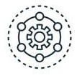
Framework
2 WEEKS OF HANDS ON PROJECT
Understanding the project goals and acquiring basic skills like using Linux, Git, Java and Dropwizard.
MCQ tests on alternate days based on the last topic taught and daily assignments.
Discussion sessions with SME and trainer about the track and technologies.
Everyday demonstration of project progress report followed by extensive work review and doubt clearance session.
Problem statement followed throughout the journey as scope of project.
All 3 aspects- Technology, Delivery and Engineering to be covered in process.
Demonstration of final product.
Notes:
1 min

Slide 3
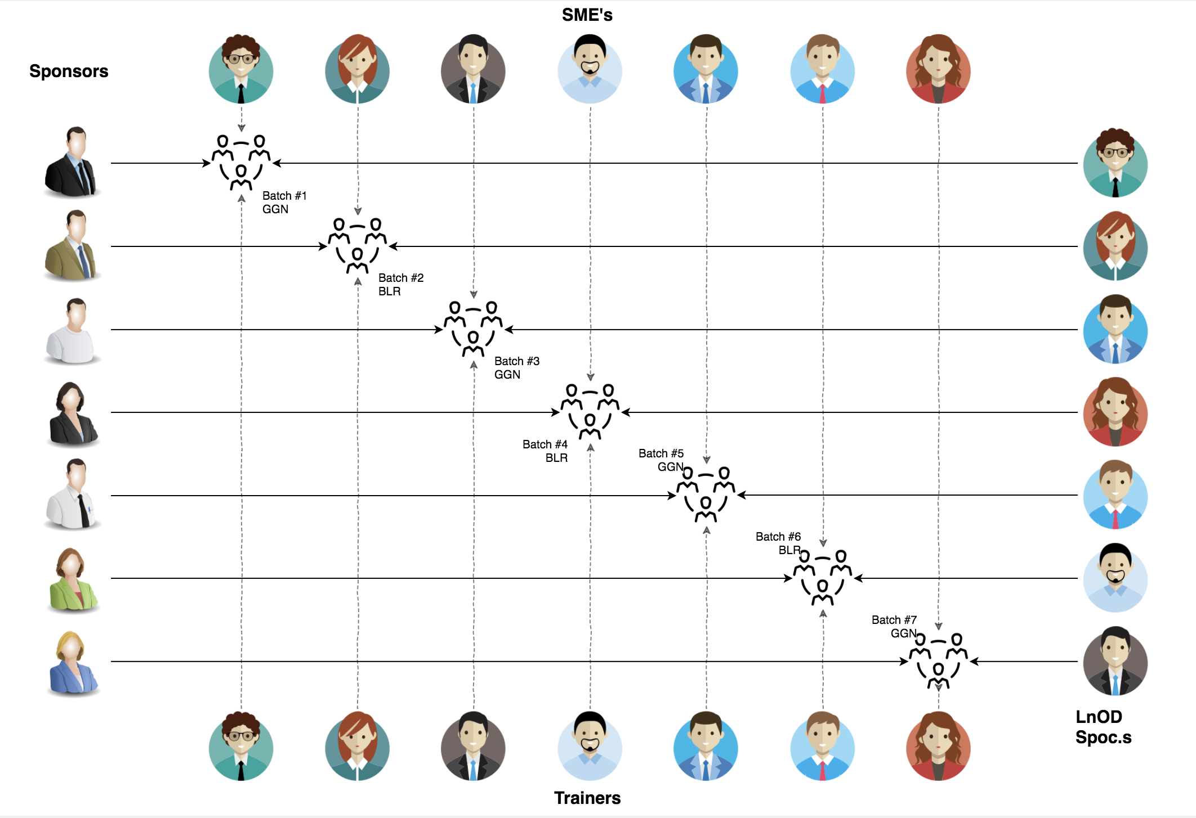
STAKEHOLDERS
Sponsors
Flipkart Pvt Ltd.
SME’s
Amit Balyan
Coordinators
Deepika Gajaraj
Notes:
30 sec

Slide 4

AGENDA
OUR JOURNEY
OUR TEAM
PROBLEM GOALS
ENGINEERING PRACTICES
TECH STACK
DEVELOPMENT
CHALLENGES AND LEARNING
DEMO
QUESTIONS
Notes:
30 sec

Slide 5






OUR JOURNEY
Understanding the project goals and acquiring basic skills
Creating Terminal based POS Application
Conversion to DropWizard Application
Designing of UML Diagrams
Adding REST functionality using JERSEY
Notes:
2 mins

Slide 6
2 WEEKS OF TRAINING + PROJECT DEMO
13 DAYS
104 HOURS
6,240 MINUTES
3,74,400 SECONDS
LIMITLESS KNOWLEDGE
Notes:
30 sec

Slide 7
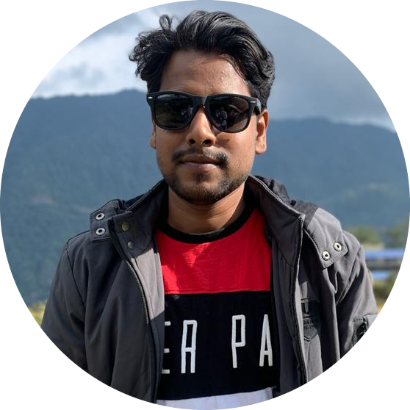
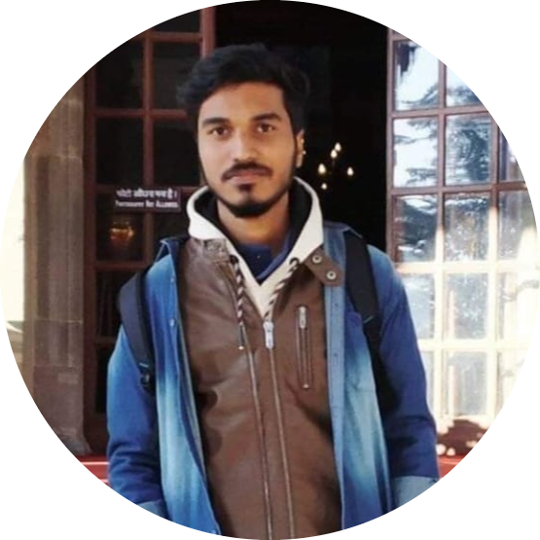
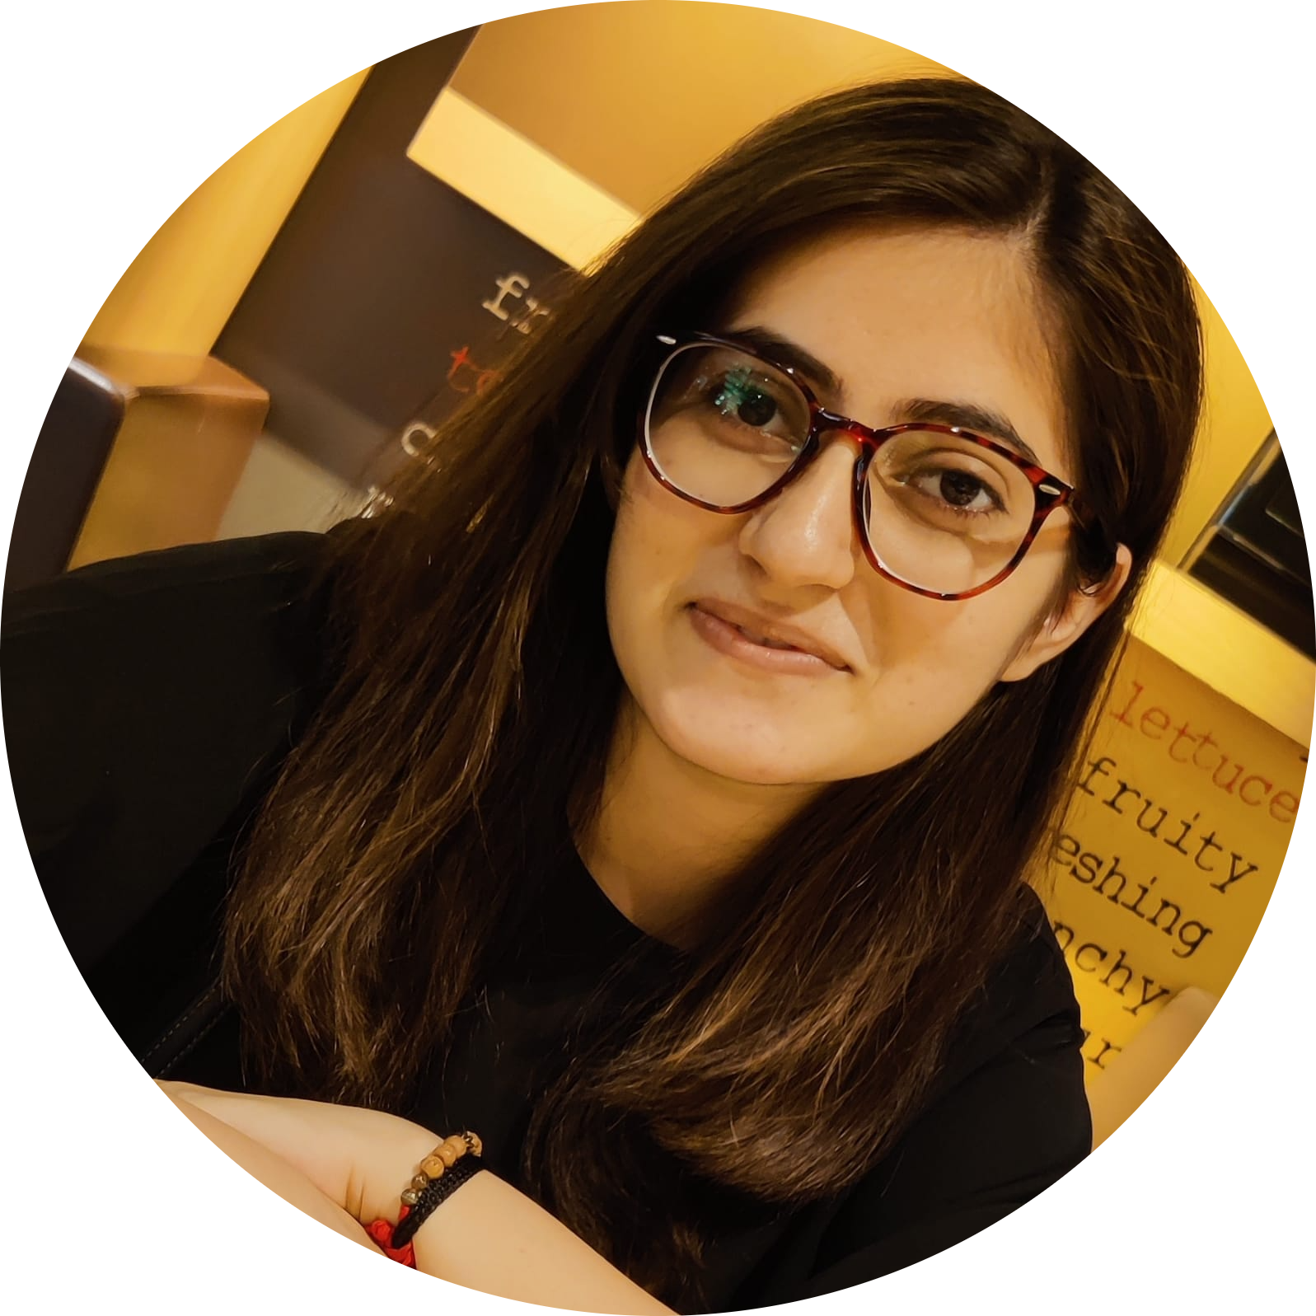
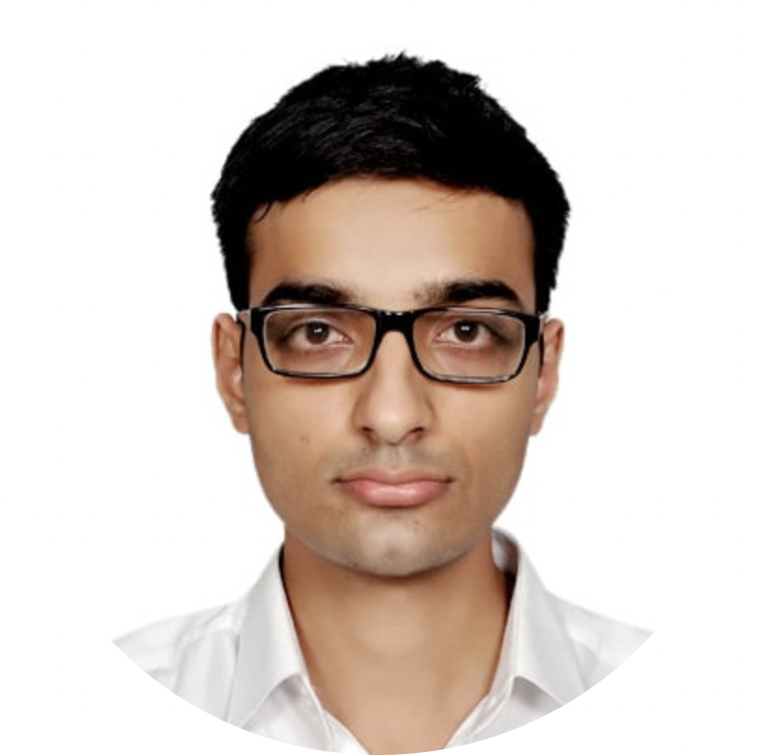
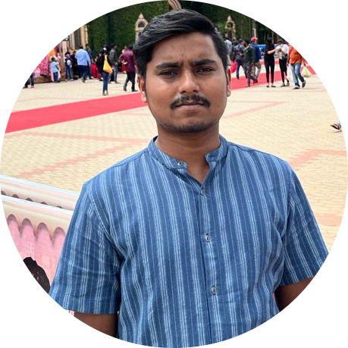
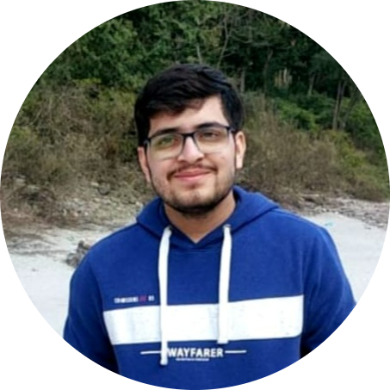
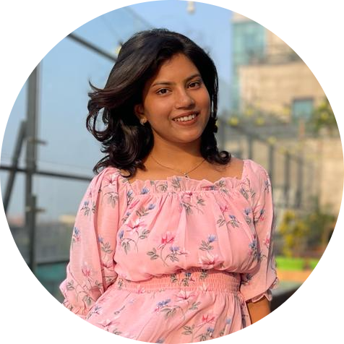
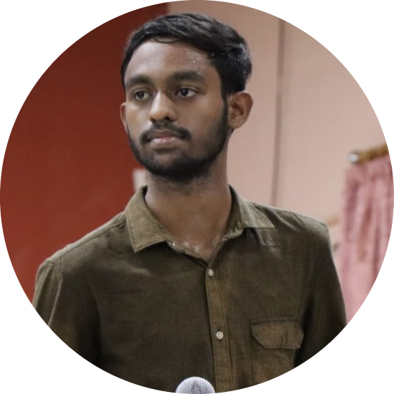
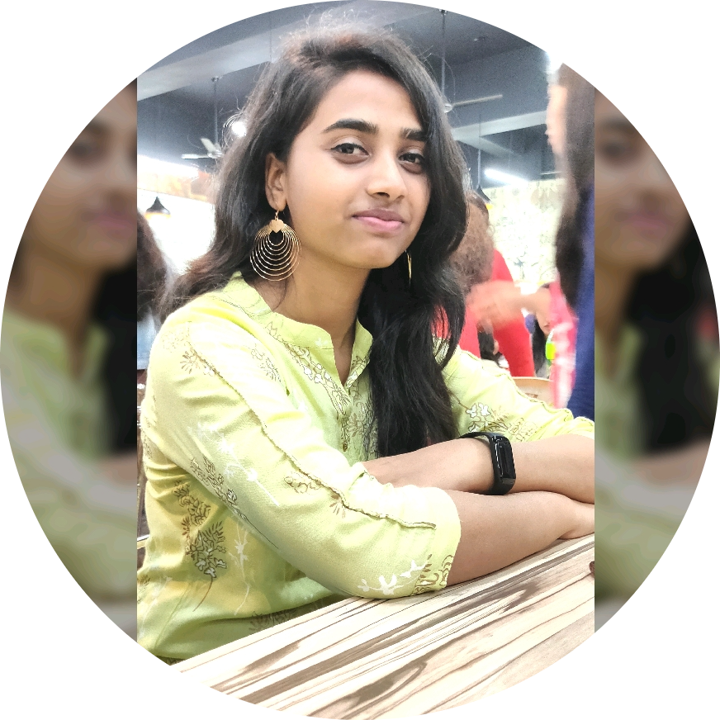
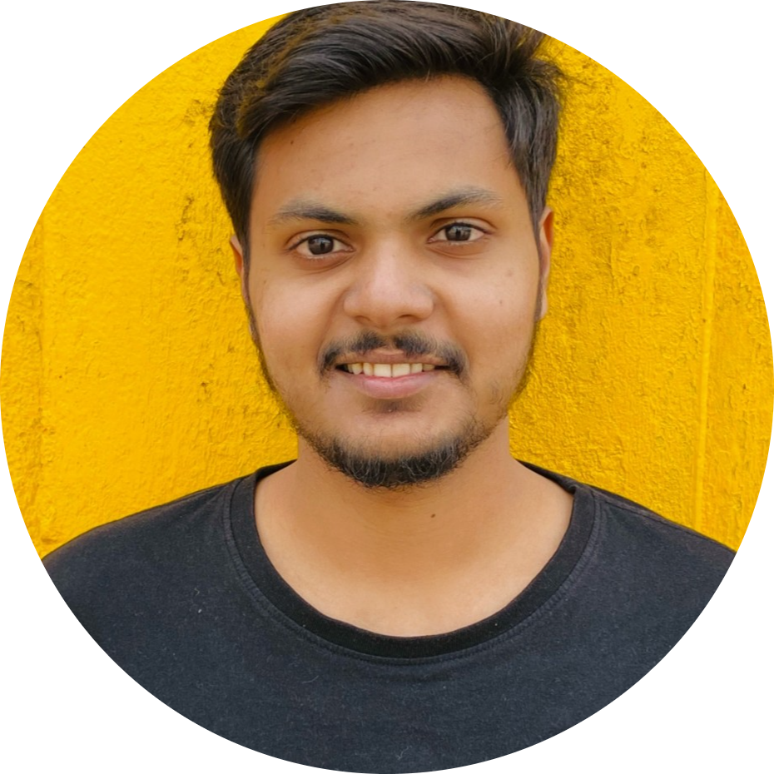
OUR TEAM
Dayanand Raut(GL)
Deepak Kumar
Harshita Mendiratta
Janmejay Singh
Harshit Kumar
J Saiteja Varma
Kashish Mittal
Kritima Kaushal
Abhishek Ranjan
Notes:
30 sec

Slide 8




OUR VISION
To create a Course Registration System which delivers a secure and interactive experience for the user adopting JAVA tech stack and Rest API/Dropwizard Framework.
Quality
Security
Interactivity
Speed
Notes:
30 sec

Slide 9

To create COURSE REGISTRATION SYSTEM using Java where a student can…
Select courses followed by registration.
Use different modes of payment for the registration
View their grade card at the end of semester
PROJECT GOALS
Other primary actors of the project includes professor and administrator
Professor can view subjects to teach, view enrolled students and grade students.
Admin manages the administration.
Notes:
2 mins

Slide 10

ENGINEERING
PRACTICES\

Slide 11
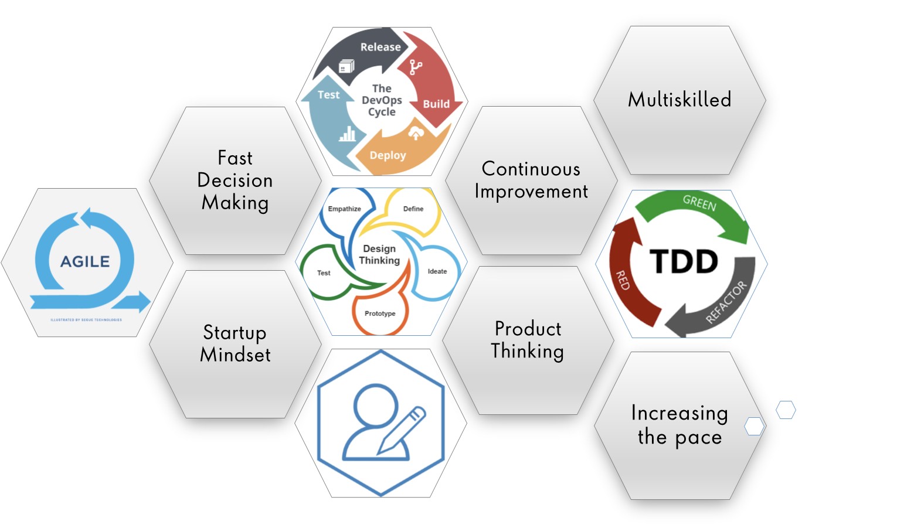
AGILE METHODOLOGY

Slide 12
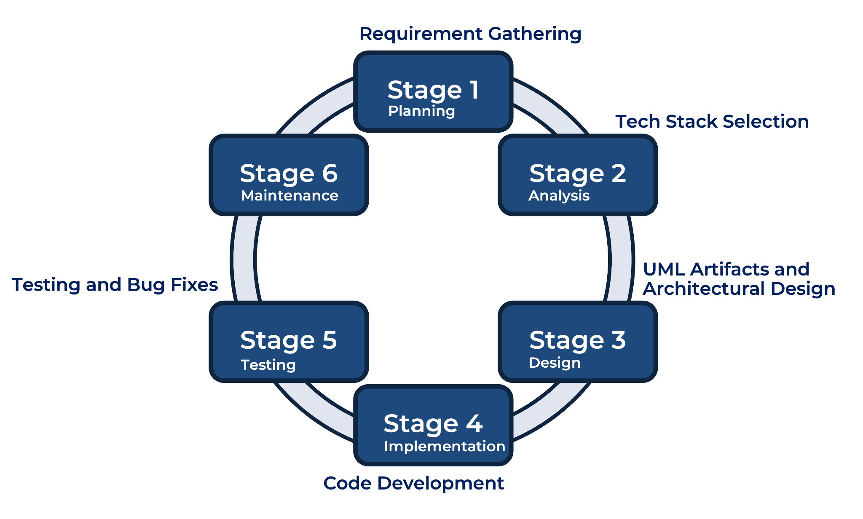
6 STAGES OF SOFTWARE DEVELOPMENT PROCESS
Notes:
1.5 min

Slide 13











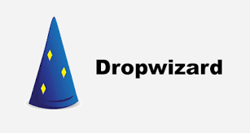
Tech Stack
Designing
Backend
Testing
Database
SCM
Notes:
1 min

Slide 14
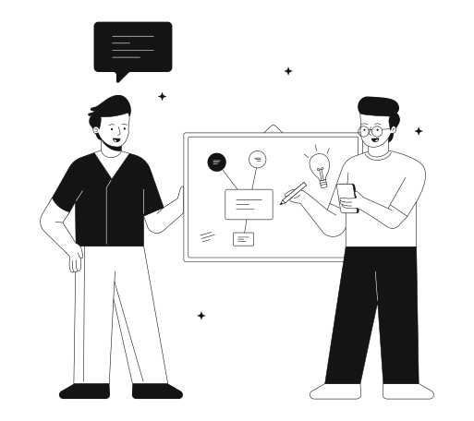
1. Planning
6. Maintenance
DEVELOPMENT
2. Analysis
3. Design
4. Implementation

Slide 15
SOFTWARE DEVELOPMENT LIFECYCLE : SDLC
Project Delivery
Integrate, deploy, test and documentation
Project Implementation
Development , Code Review and Commit
Software Development Life Cycle (SDLC) is a process used by the software industry to
design, develop and test high quality softwares.
Project Grooming
Requirement understanding, analysis and estimation
Project Planning
Understanding scope and goals of project, UML modelling and database designing
Notes:
2 mins

Slide 16
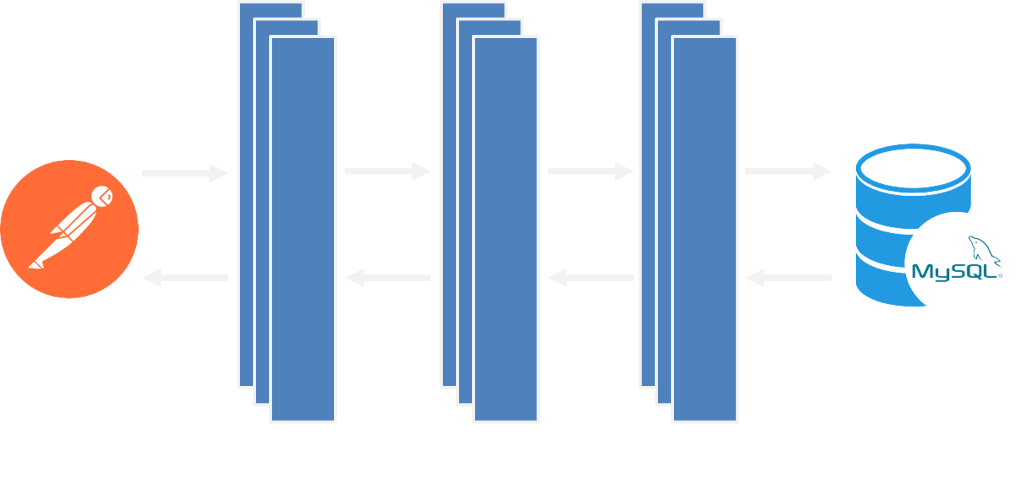
SYSTEM ARCHITECTURE
Notes:
2 mins

Slide 17

CHALLENGES
AND LEARNINGS

Slide 18
Understanding the problem statement and the initial implementation using Use Case, Activity, Sequence and Class Diagram.
Conflicts while merging and collaboration in Git
Resolving error due to version mismatch among libraries
Migration of project from one tech stack to another
Database Integration challenges
CHALLENGES
Notes:
1 min

Slide 19
Familiarization with Unix, Git, and Rest Commands.
Life cycle of the Project
Knowledge of UML Artifacts
Learning and Implementing new Java 8 features
Integration of REST Services with Java code using Jersey.
Leart to configure Maven and Dropwizard
Use of Postman for testing APIs
Team work and code collaboration
LEARNINGS
Notes:
2 mins

Slide 20

Let’s start
with the
UML Artifacts

Slide 21
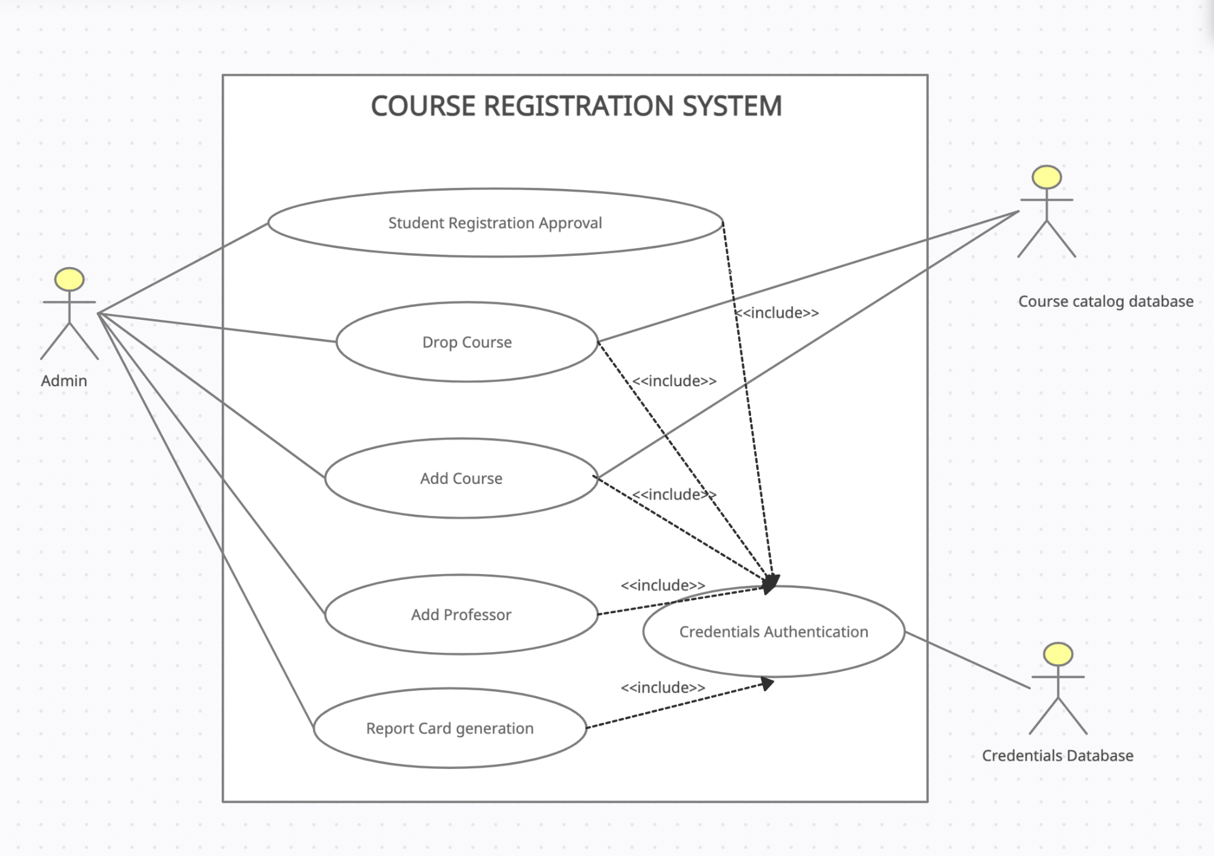
Admin Use case Diagram

Slide 22
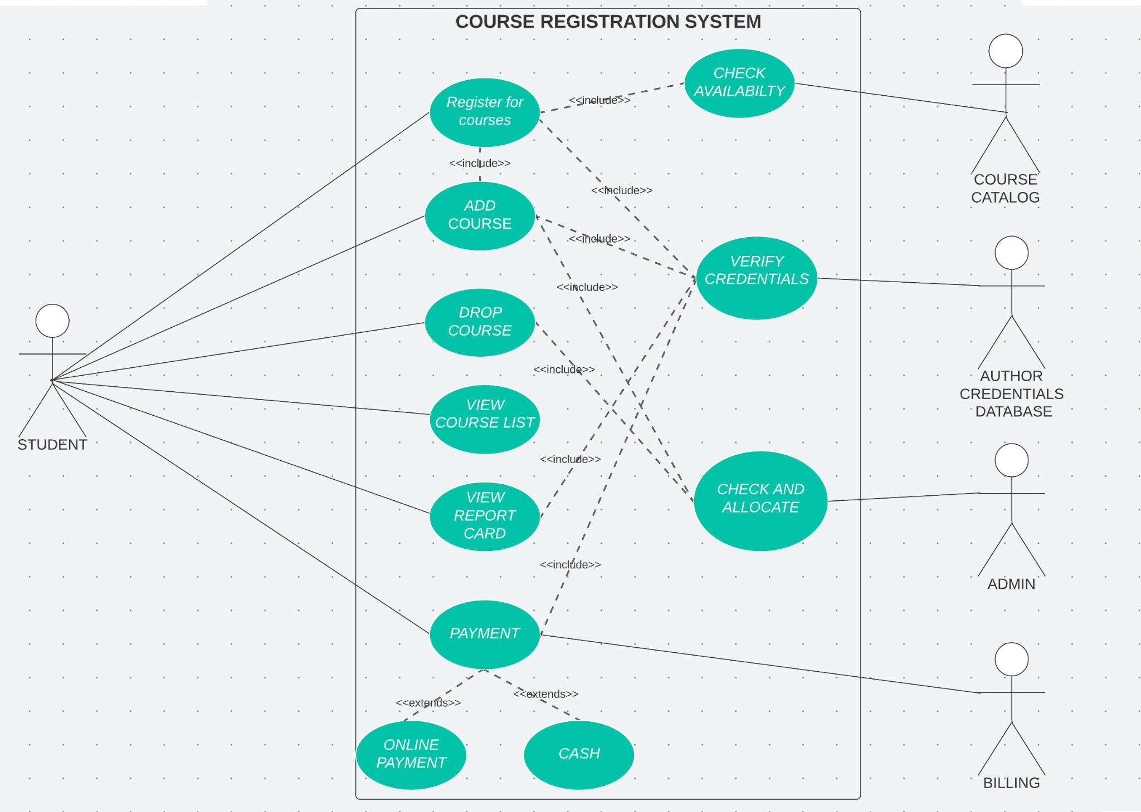
Student Use case Diagram

Slide 23
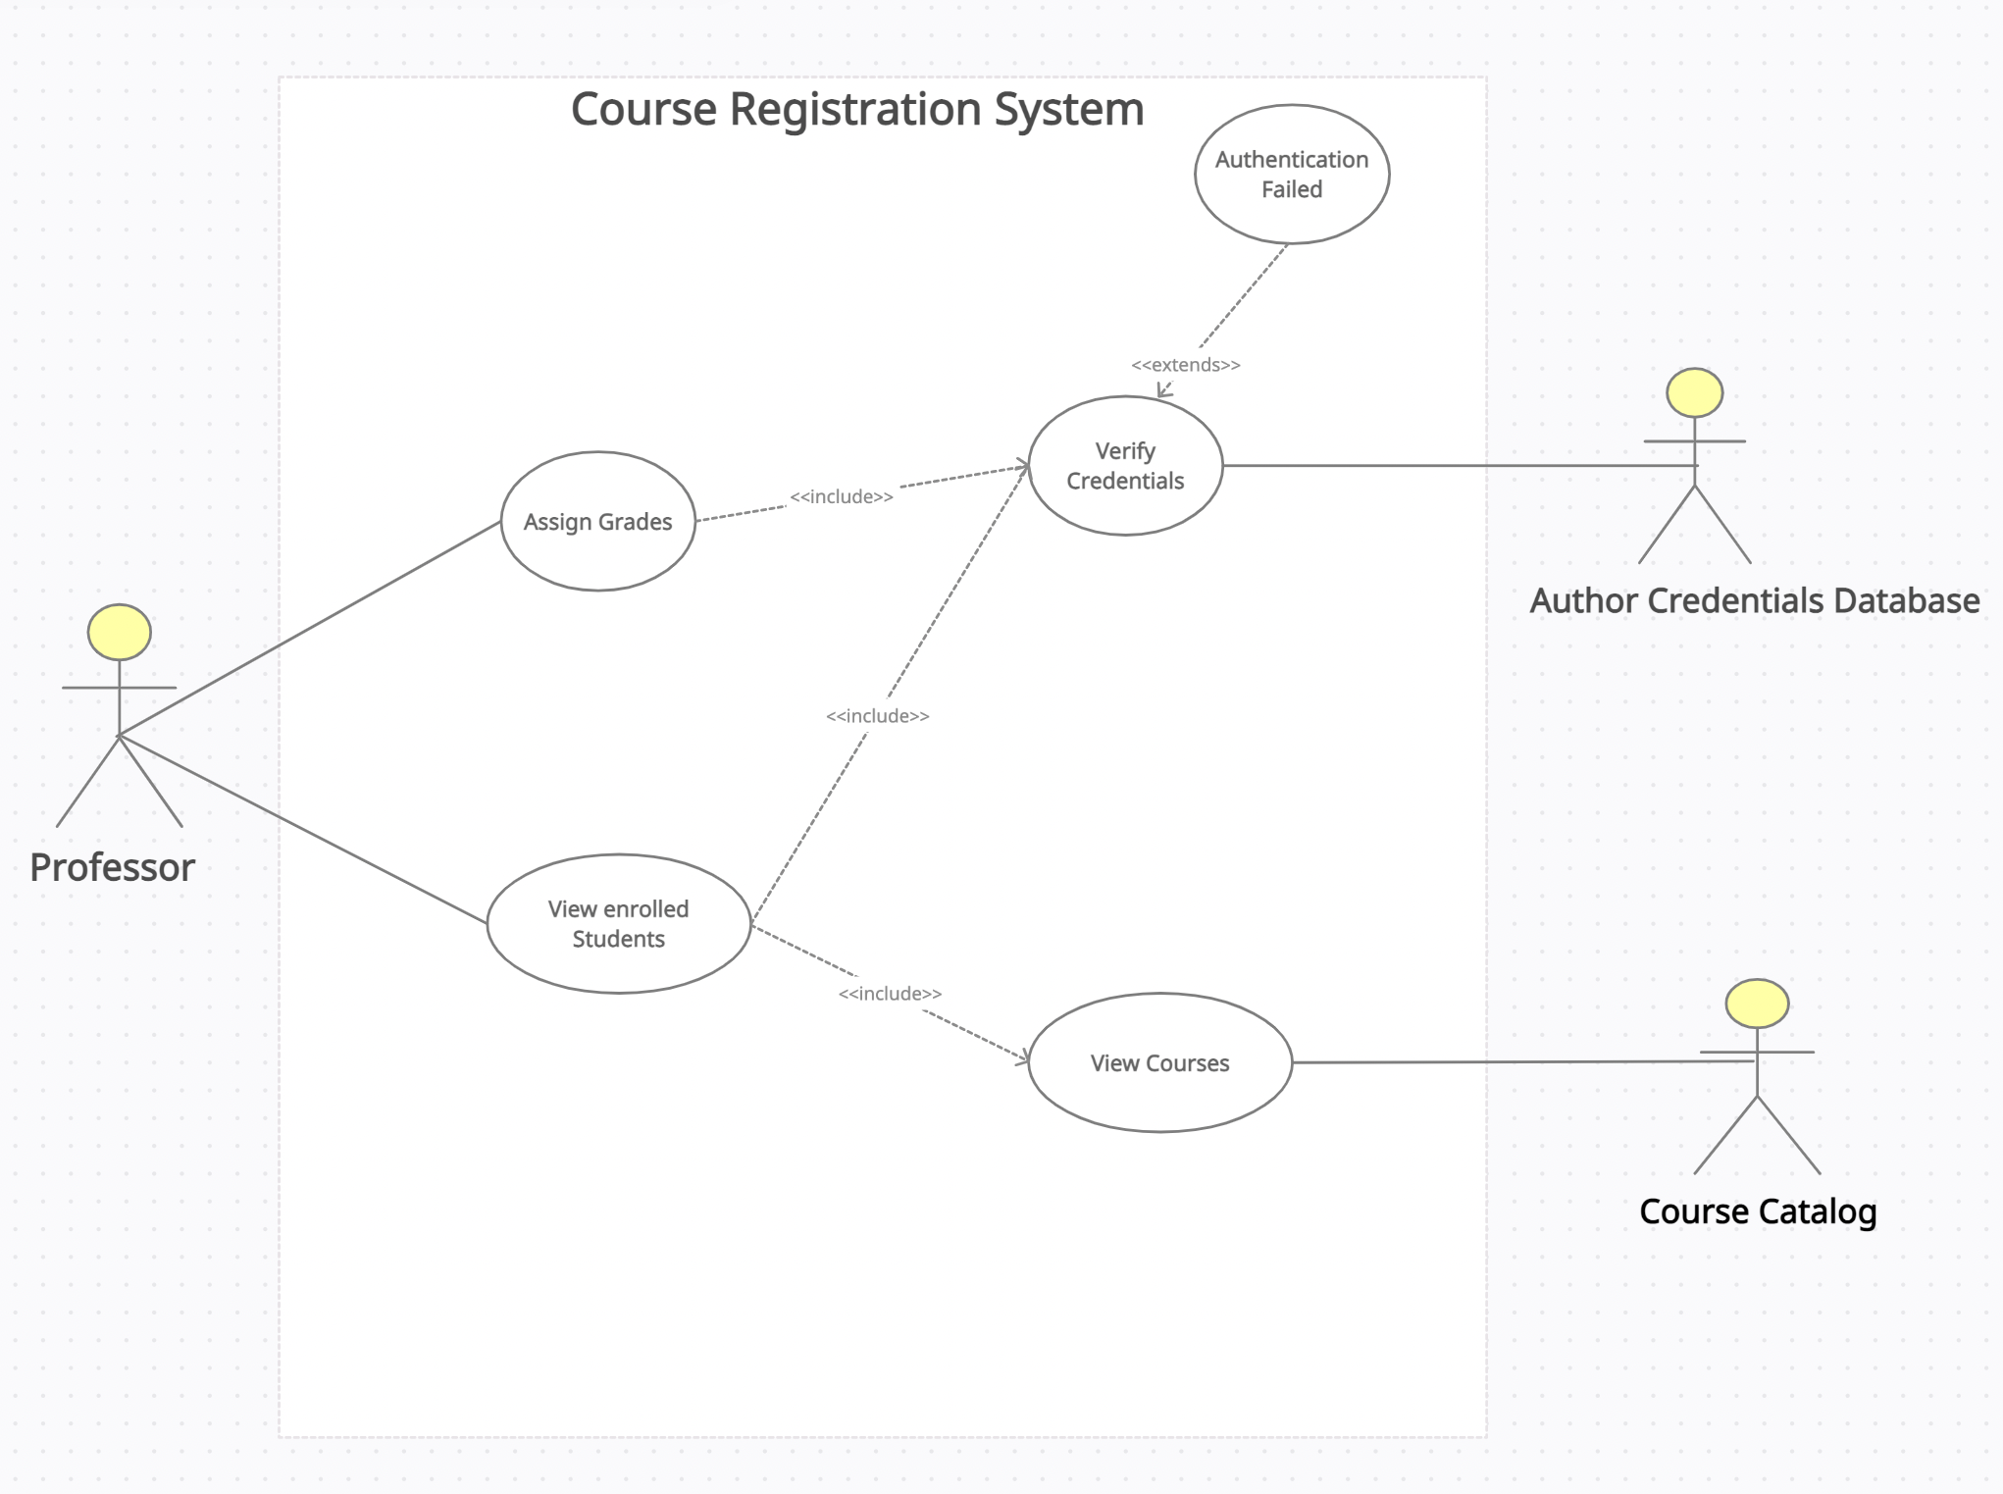
Professor Use case Diagram

Slide 24
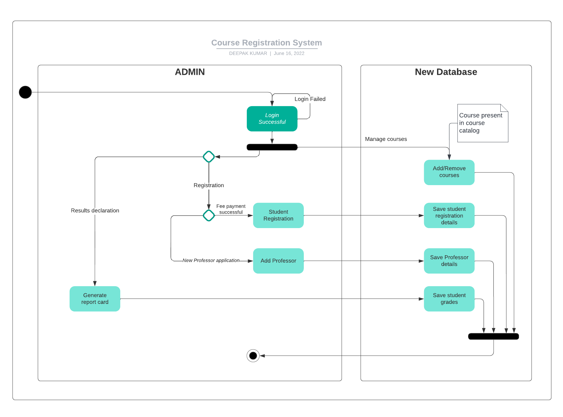
Admin Activity Diagram

Slide 25
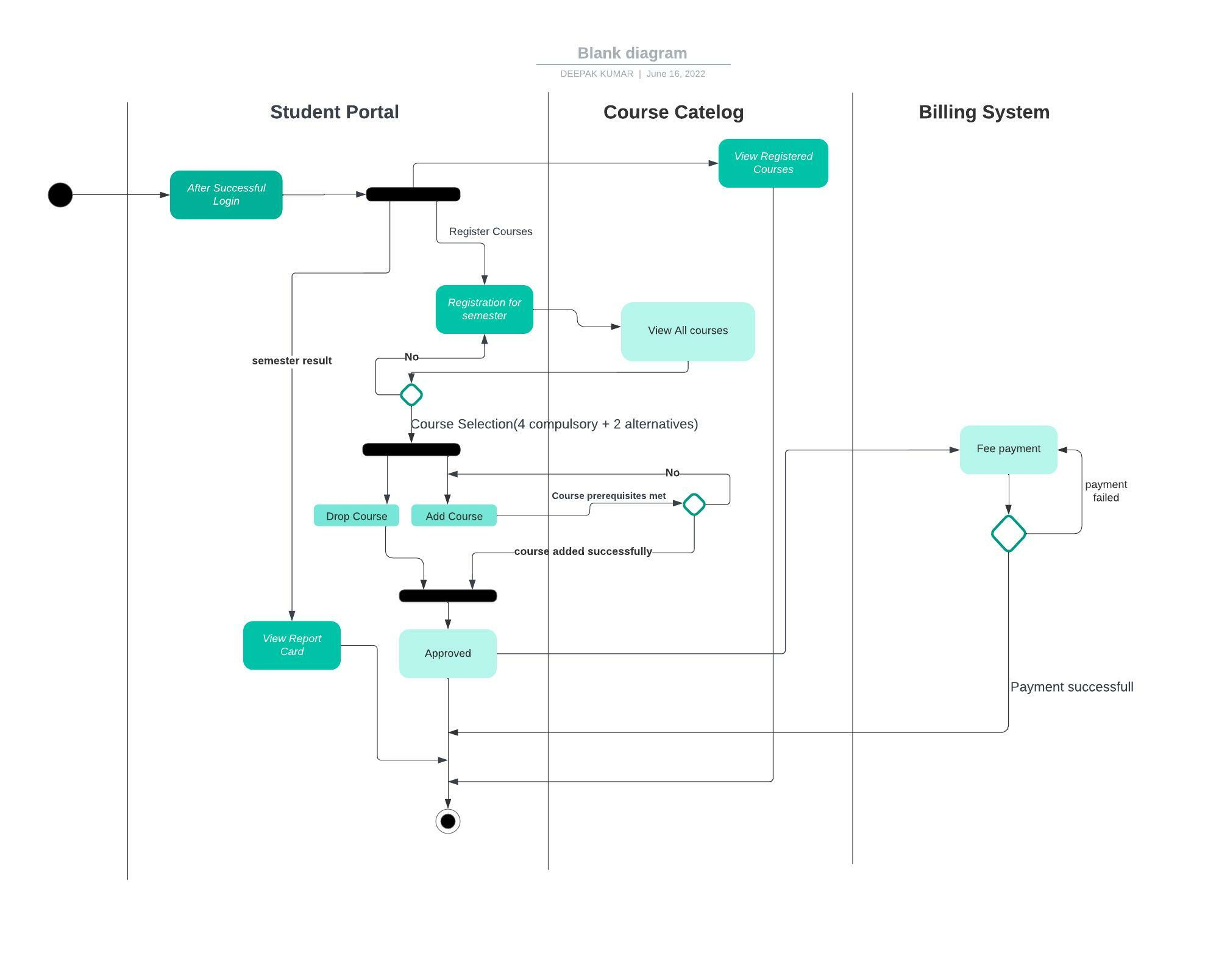
Student Activity Diagram

Slide 26
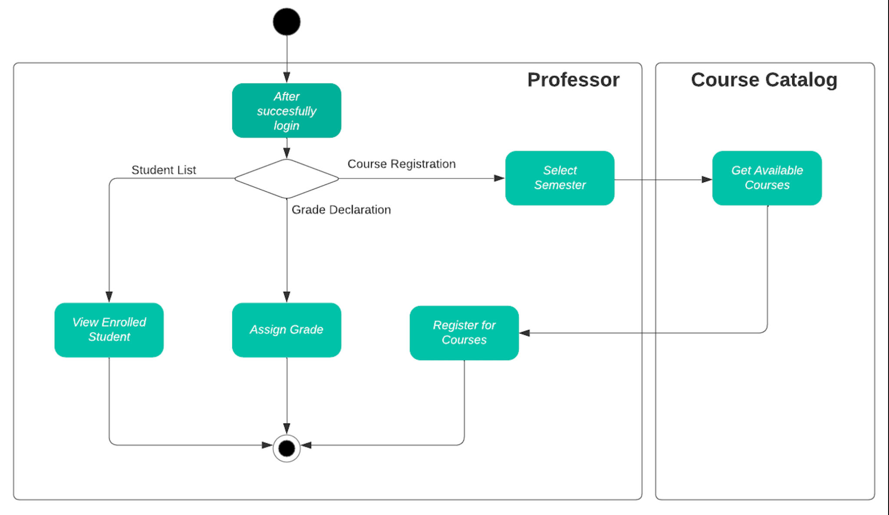
Professor Activity Diagram

Slide 27
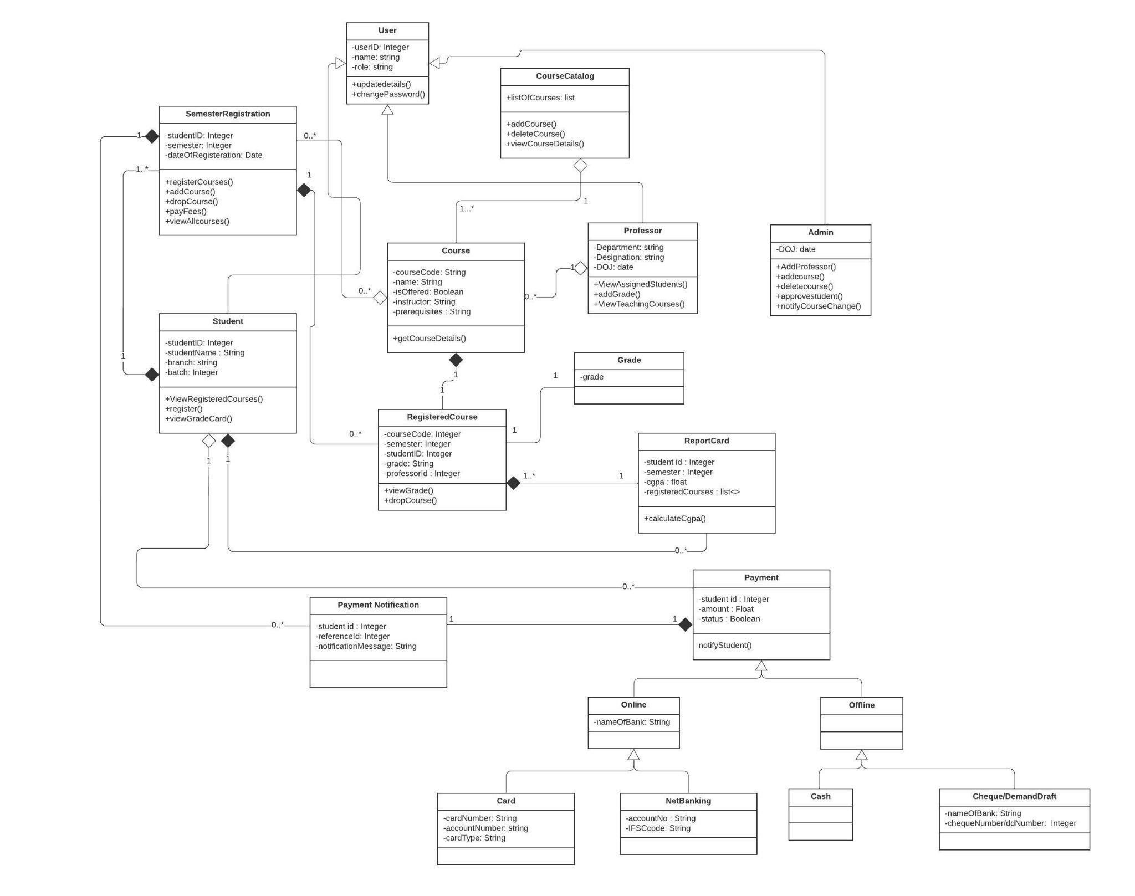
Class
Diagram

Slide 28
Let’s start with the Demo

Slide 29

Any Questions ?

Slide 30

Thank You !

